Slide 1
Expanding Dual Enrollment & Early College High School
A Powerful Strategy For Increasing College Success
By Dr. Daniel P. King, Superintendent

Slide 2
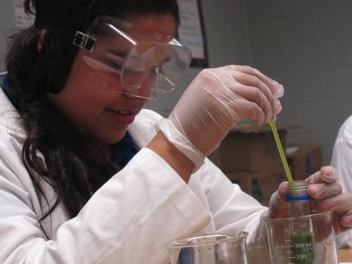
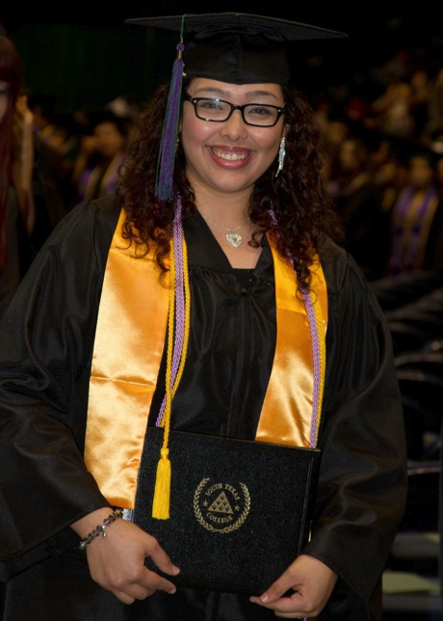
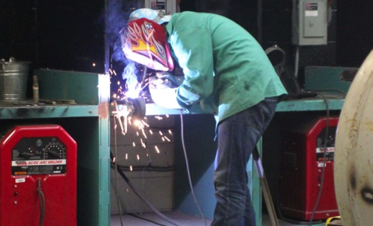
START COLLEGE NOW! COMPLETE EARLY! GO FAR!

Slide 3
Building Pathways:
PSJA ISD Collegiate Academies

Slide 4
PSJA ISD Collegiate Academy
PSJA ISD Collegiate Academy
Computer Science Academy
Engineering/Architecture Academy
Nursing and Allied Health Sciences Academy
Mathematics and Science Academies
Technology Academy
Basic Coursework

Slide 5
PSJA ISD Collegiate Academy
PSJA ISD Collegiate Academy
Student Union Center
Criminal Justice Academy
Automotive Academy
Welding Academy
Conference Center
Multi-Media/KTRI Academy

