Slide 1
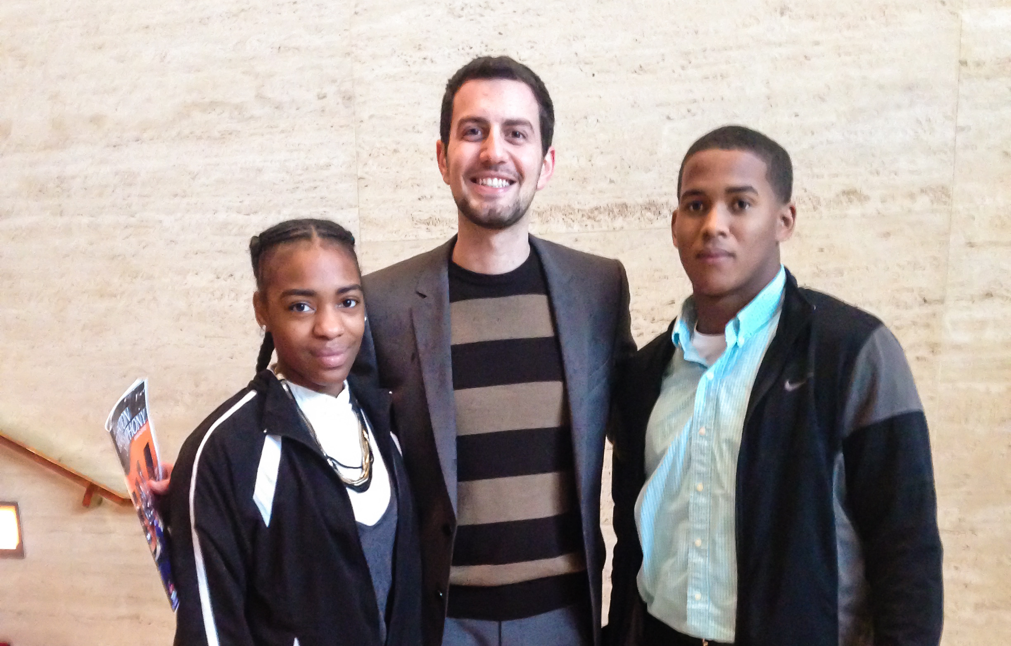
Vibrant communities that build trust, become inclusive, and, in return, leverage their strengths to solve their own problems. Communities that maximize opportunities for all children regardless of their socioeconomic background

Slide 2
Collective High Performance: Creating Alignment
Vision
Current Reality

Slide 3
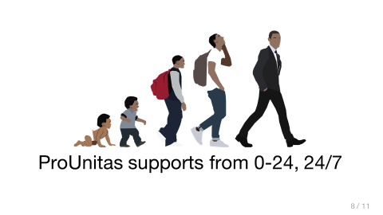
ProUnitas Mission
To facilitate the effective entry, coordination and implementation of Houston’s existing educational, health and social services for underserved communities.

Slide 4
In the News
“Get tough” prison sentences fail to reduce fear of violent crime
Homeless shelters perpetuate homelessness
Food aid leads to increased starvation
Job training programs increase unemployment
Drug busts increase drug-related crime

Slide 5
What do these stories have in common?

Slide 6
Failed Solutions Have Common Characteristics
Address symptoms vs. underlying problems
Obvious and often succeed in the short run
Short-term gains undermined by long-term impacts
Negative consequences are unintentional
If the problem recurs, we do not see our responsibility

Slide 7
Good Intentions Are Not Enough
When you are confronted by any complex social system … with things about it that you’re dissatisfied with and anxious to fix, you cannot just step in and set about fixing with much hope of helping. This is one of the sore discouragements of our time.
If you want to fix something you are first obliged to understand … the whole system.
Lewis Thomas

Slide 8
Systems vs. Conventional Thinking
Conventional Thinking
Systems Thinking
The connection between problems and their causes is obvious and easy to trace.
Others, either within or outside our organization, are to blame for our problems and must be the ones to change.
A policy designed to achieve short term success will also assure long term success.
In order to optimize the whole, we must optimize the parts.
Aggressively tackle many independent initiatives simultaneously.
The relationship between problems and their causes is indirect and not obvious.
We unwittingly create our own problems and have significant control or influence in solving them through changing our own behavior.
Most quick fixes have unintended consequences: they make no difference or make matters worse in the long run.
In order to optimize the whole, we must improve relationships among the parts.
Only a few key coordinated changes sustained over time will produce large systems change.

Slide 9
The Core Challenge of Economic Inequity
Earning Power of
Advantaged
Earning Power of
Disadvantaged
Income Generated by
Advantaged vs.
Disadvantaged
(Economic Inequity)
R1
R2
Access of Advantaged
to Resources
Access of Disadvantaged
to Resources
R3
Self-Justification and
Fear of Loss
Segregation
To Vicious Cycles of Poverty

Slide 10
Treading Water
Ending Homelessness and
Developing Affordable Housing
B9
Ability to Pay for
Quality Housing
Human Services
(e.g. healthcare, food, childcare,
early childhood,
parental counseling)
Strength of Family
(Ability to Provide
Stability, Parenting,
Education Support)
B7
R5
Mass Incarceration
Educational Programs
(e.g. pre-K to post, mentorship, juvenile justice prevention, enrichment)
Personal Health
and
Access to Childcare
Criminal
Behavior
R6.1
B8
Education Performance
(Self, Social, Content)
R6.2
Generational
Time Delay
Earning Power
(Living Wage Jobs)
B10
R4
Workforce and
Local Business
Development

Slide 11
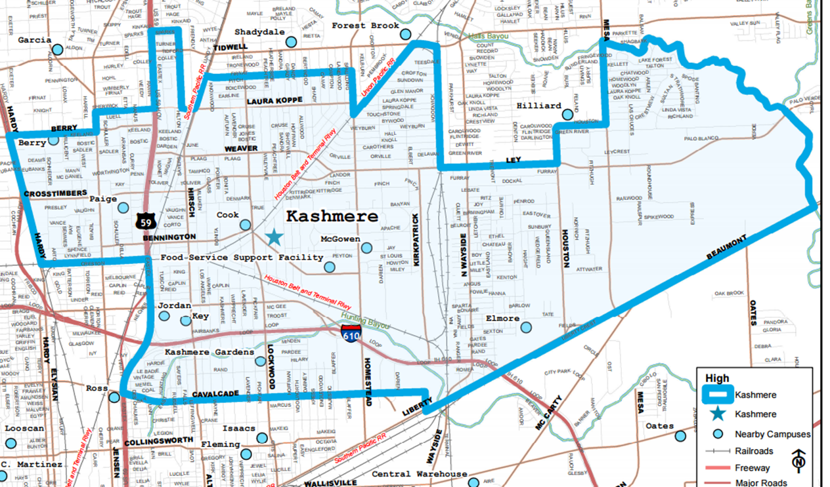
Kashmere/Trinity Garden School Feeder Pattern
Current Reality
Home to the longest-running, low-performing public school in Texas
53 percent of adults earn less than $25,000 a year
The area lacks comprehensive health providers
No Head Start programs
Classified as a food desert.
Most residents either have one car per family or rely on public transportation.
Schools were reconstituted multiple times as well as part of the school turn around initiative Apollo

Slide 12
The Issue at Hand - As a country, we have become program rich but system poor.
Our children come to us with numerous needs and no one program or teacher possesses the capacity to solve them all…
Social needs
Healthcare
Mentorship and counseling needs
Educational needs

Slide 13
ProUnitas is not a program but rather a system based organization with a focus on feeder patterns…
Community Council
Civic Engagement
ProUnitas
Youth Council
Birth - 5
Service Linkage
School Based
18-24

Slide 14
ProUnitas is not a Program but rather a System Based Organization – managing more than 45 agencies…*
Supports and provides the tools for a community to play a crucial role in solving its own problems.
Ensures that the availability and access of the programs and services is not dependent on the number of needs that a child presents.
Ensures that programs are not working in silos, but are parts of a greater community vision.
Provides a clear pathway for children to exit the cycle of poverty, by facilitating the entry and coordination of services in a fashion that supports their holistic growth.

Slide 15
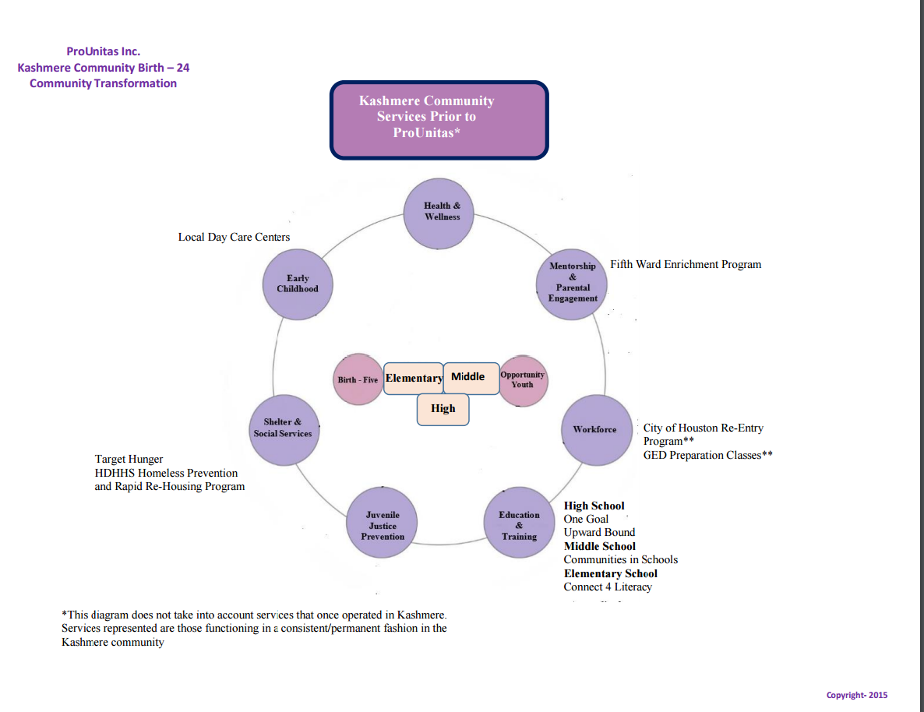
Kashmere Feeder Pattern Before ProUnitas

Slide 16
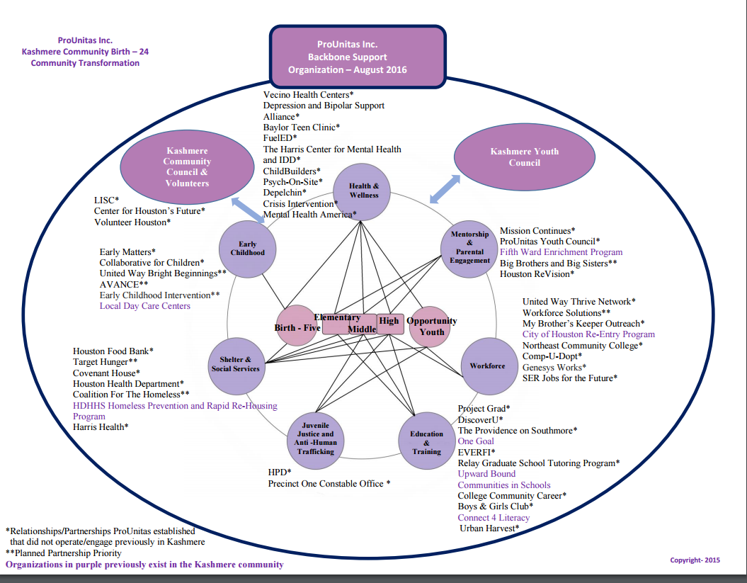
Kashmere Feeder Pattern Today – Expanding to additional Elementary School in 2017

Slide 17
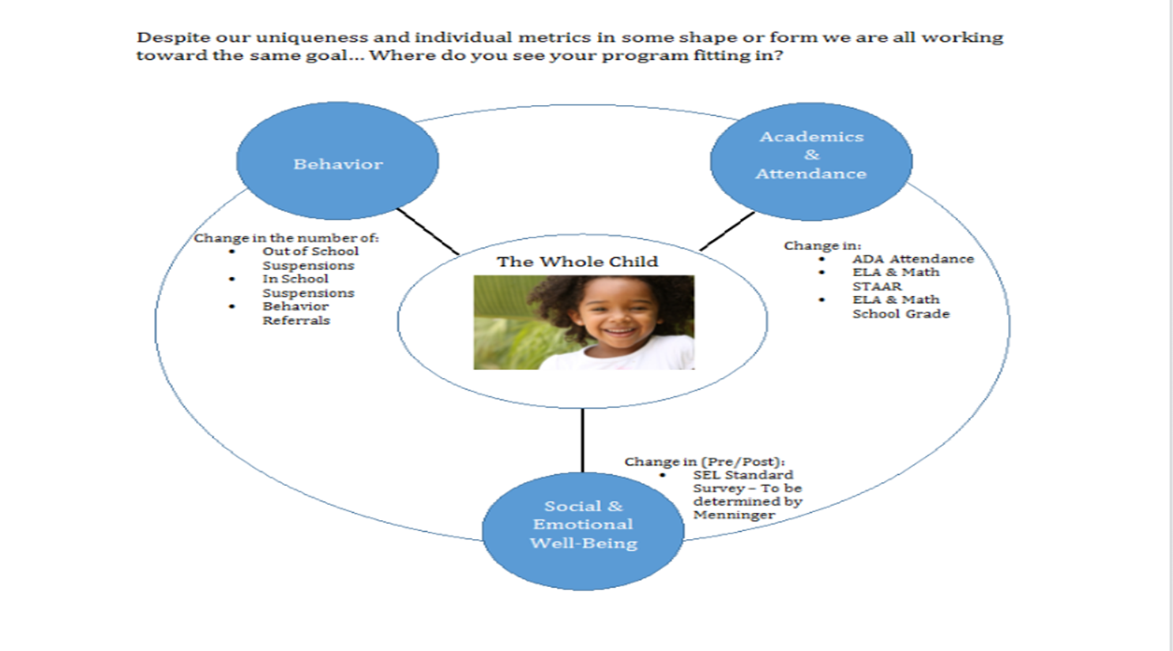
Shared Vision

Slide 18
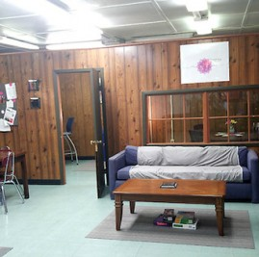
Where…..
School-Based Success Centers
Majority of services take place out of the Success Center
E.g. service(s) include two full time additional counselors, academic tutoring, health/mental services, job placement, social services and many more

Slide 19
What we will be doing on campus…
Managed by a full time ProUnitas Linkage Manage on school campus

Slide 20
Where do I begin….
Vision, Mission, Values
(What you want)
Creative Tension
Current Reality
(What you have)

Slide 21
Bright Spots
Collaborative effort between TEA, community, service providers and Houston ISD
We cannot address the finish line without addressing the start line – Planned expansion to cover all elementary schools within feeder pattern by end of 2017
Early gains in student level outcomes and system level outcomes
Continue to assess our decisions against long term sustainability

